Slide 1

RockRoutes
Creators:
Adilah Amalia
Raquibbi Samaun
Liliana Coronado
Martin Portillo

Slide 2
Goal & Motivation
Original Plan:
Provide a clear visualization of the routes to climb. Users can turn on and off the level of difficulty (grade) they want to see, what kind of climbing they want to do (rock or boulder), and the type they can choose from (trad, sport, alpine).
Why:
Mountain Project, rock climbing website, has a lot of routes and it takes a lot of time to sort. Reason why we want to create something that is more specific and cleaner to look at - especially for beginners.
Who:
Beginner rock climbers looking to climb in the state of Colorado.
Problem Getting Fixed:
Mountain Project is hard to navigate and it does not show a clear and clean looking map that is easy to follow.

Slide 3
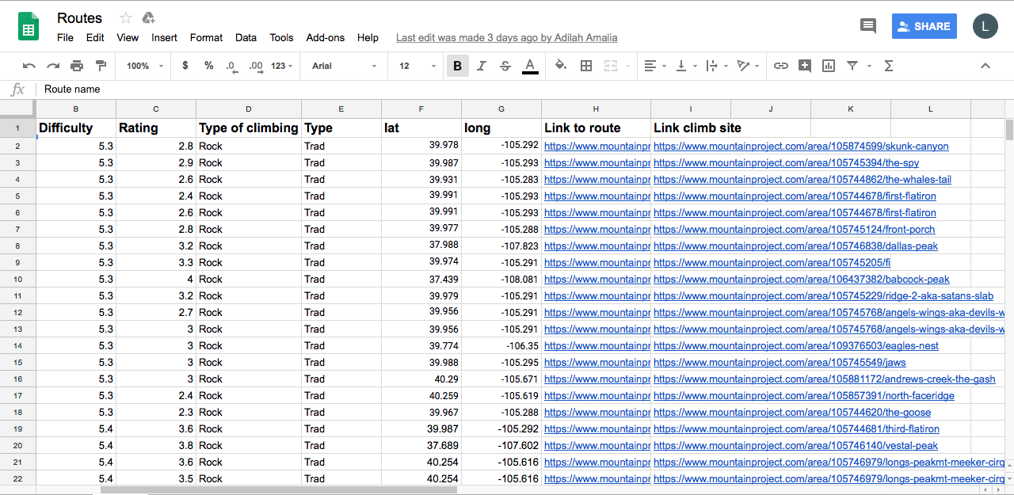
Data Collection
Where Is the data from?
Mountain Project - https://www.mountainproject.com/
How was it collected?
Each person in the group was assigned a specific difficulty level to get the data from.
133 total routes collected from 9 different difficulty levels

Slide 4
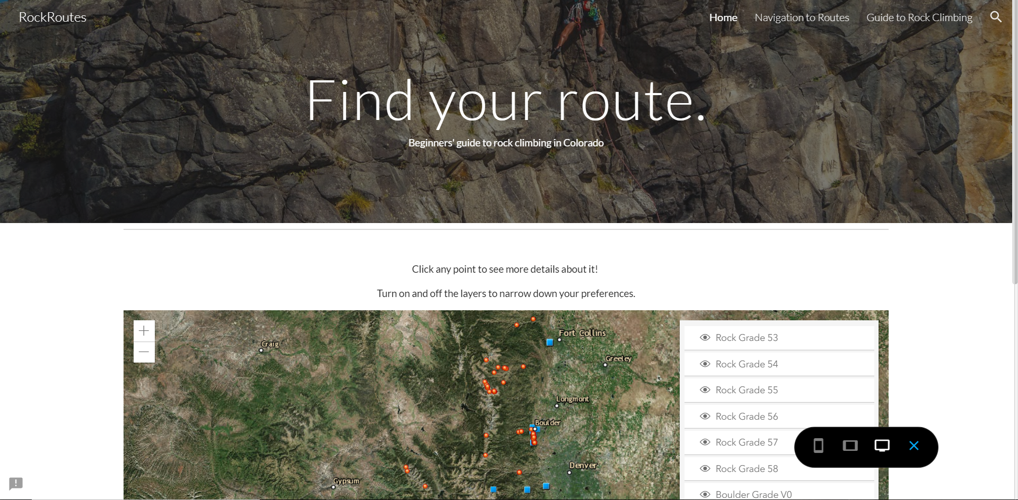
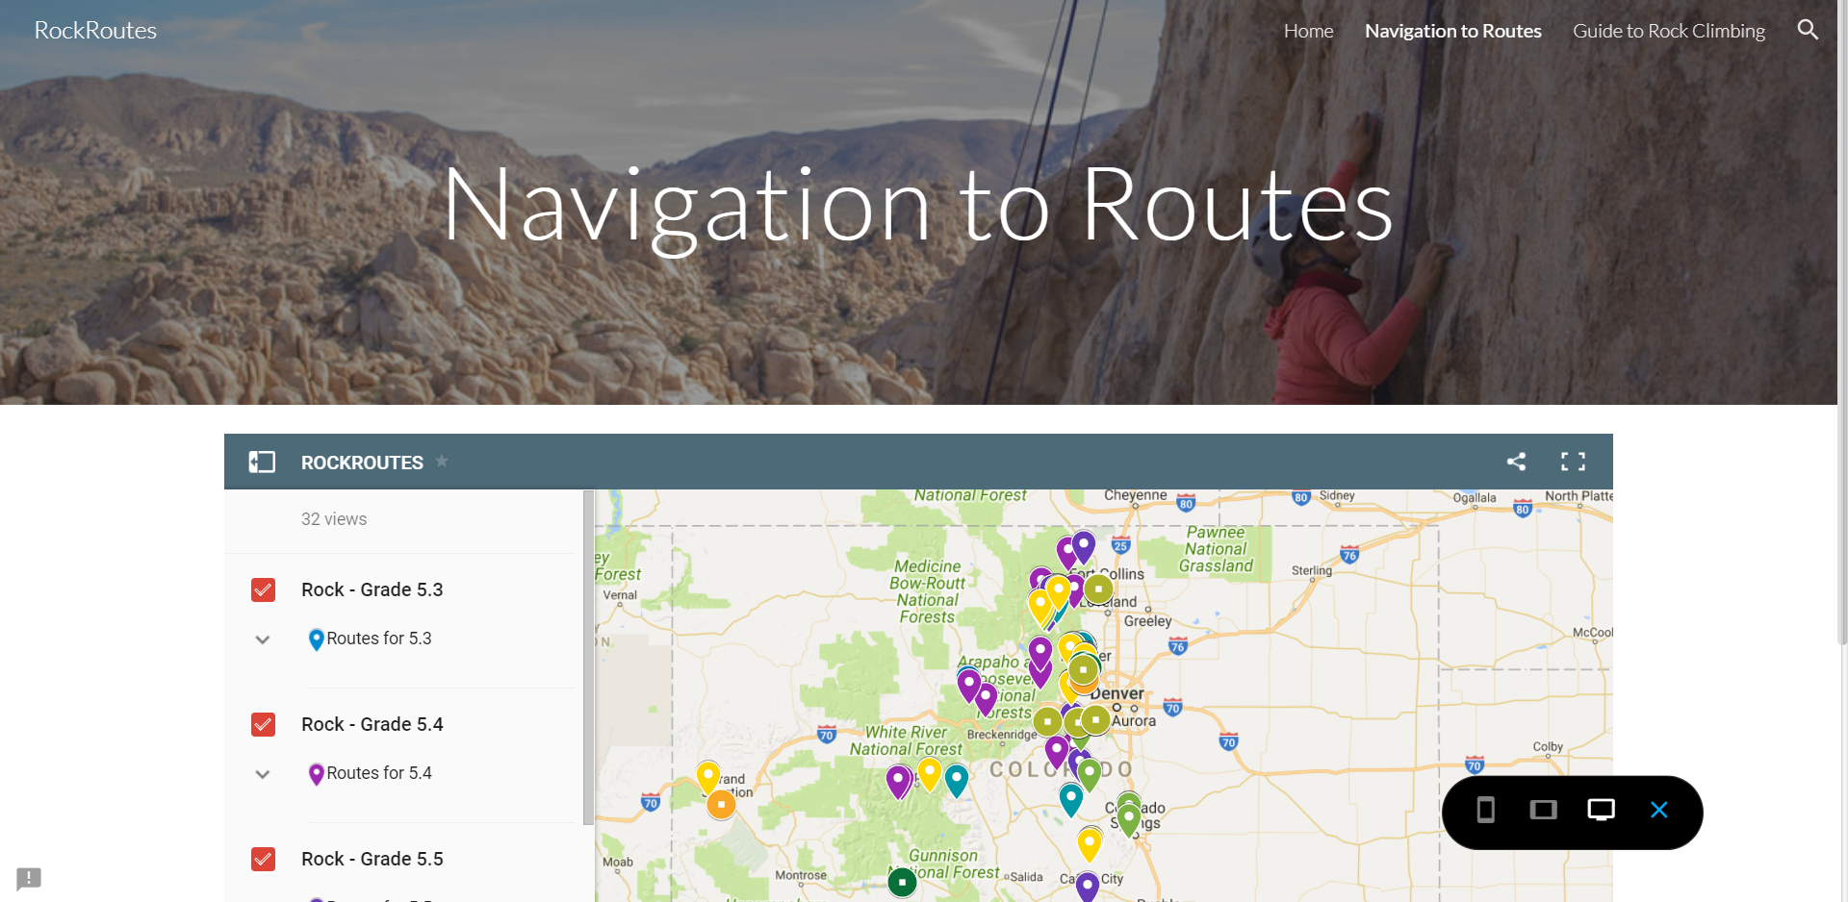
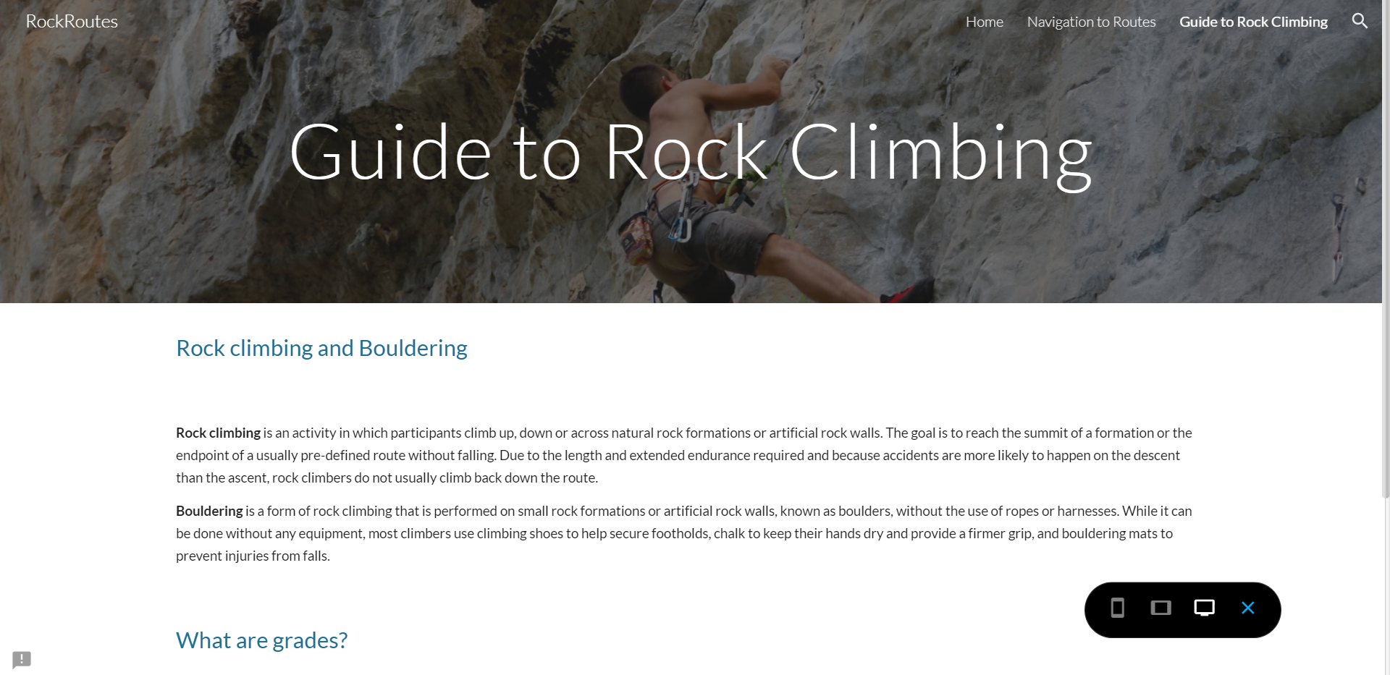
Website Layout
Navigation Bar Between Pages
Page Title
Map View

Slide 5
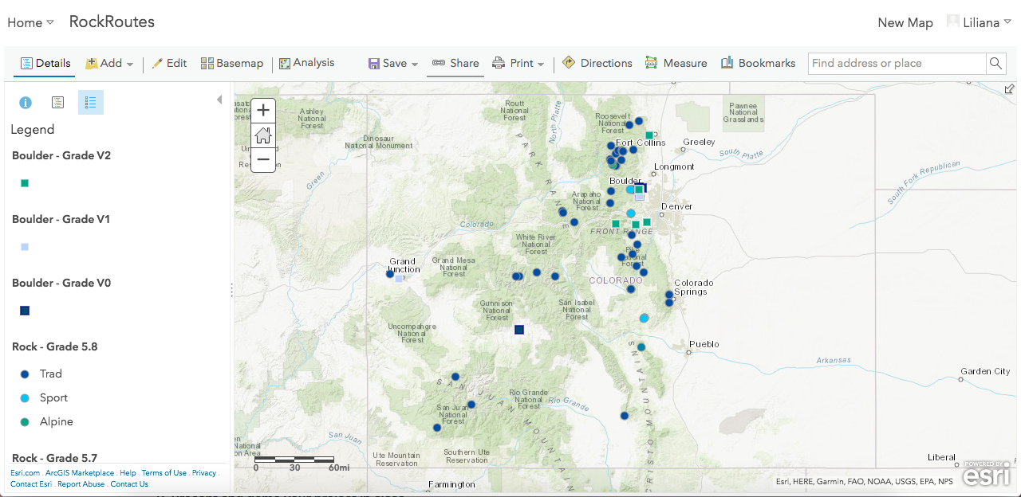
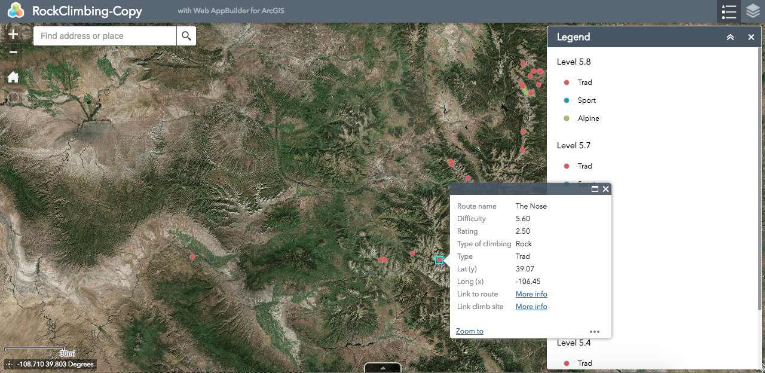
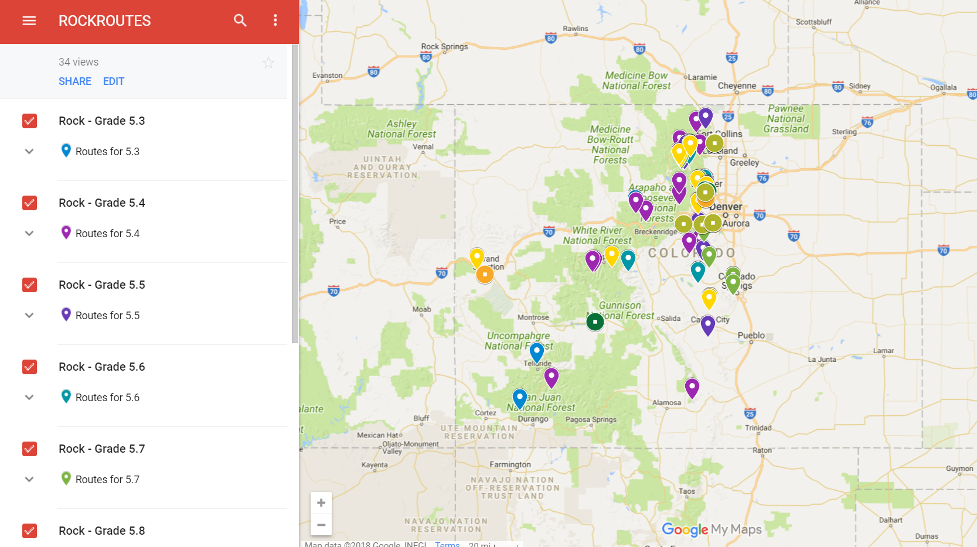
Creating Map
Step 1:
Shapefiles were created with the spreadsheet of the data that was collected from the Mountain Project website. Once that was done, the shapefiles were uploaded to ArcGIS online as hosted feature layers.
Step 2:
Code was written to call on the hosted layers on ArcGIS online and symbology was assigned for the different grades of climbing being done on each point.
Step 3:
The map was embedded onto the website through HTML.

Slide 6
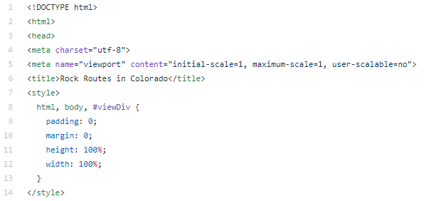
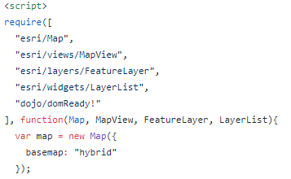
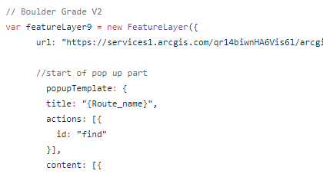
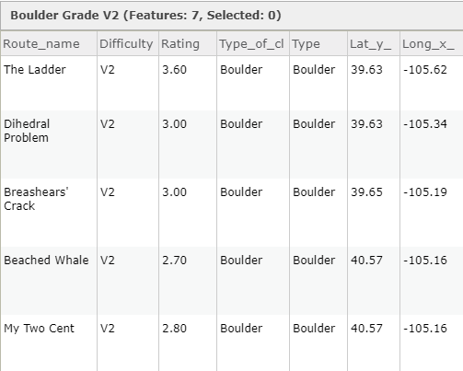
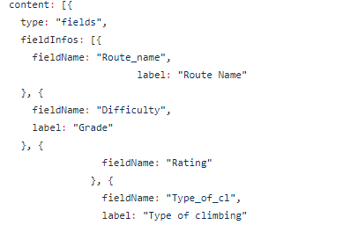
Code
Description:
JavaScript and HTML were used to write the code behind the map.
Mainly used code that linked the shapefiles to populate a map that was embedded in our website. Different templates of code were used such as popup and layerlist.
We referenced a lot of lab from week 11 of class, as this lab was really helpful in showing us how to link the shapefiles we created to the interactive map on our website.
https://github.tamu.edu/GEOG478Project/RockRoutesCO/blob/master/CODE/MAP.html

Slide 7
https://sites.google.com/tamu.edu/rockroutes/home

Slide 8
Discussion
Expectations:
This webpage is expected to help beginner rock climbers to browse and find routes they can climb in Colorado. It can help them to navigate to the route quickly, as well as provide them with introduction info to climbing.
Finished Product:
The website is able to be accessed via desktop or mobile devices where the user can turn on and off layers based on the climbing types and grades they prefer. The home page lets them browse the location based on preference. The navigation page connects them to Google Maps. The guide page informs them about rock climbing.

Slide 9
Conclusion
In conclusion, we reached our goal of having a
Map with the ability of choosing which routes in specific want to be seen by the user
Map helping the user navigate to the route using google maps
Beginners’ guideline to rock climbing

